Slide 1
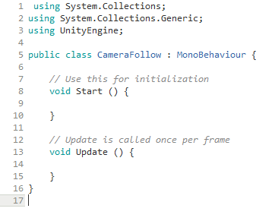
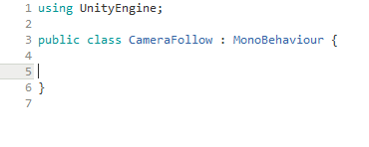
1)
So first of all we can make things look a lot nicer and cleaner by removing the two using tags at the top and both of the methods

Slide 2
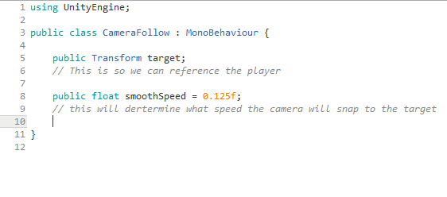
2) Next we want to have a reference to what our target is going to be, this being the player and then we also need a speed of that will be on how long it will take for the camera to reach the player

Slide 3
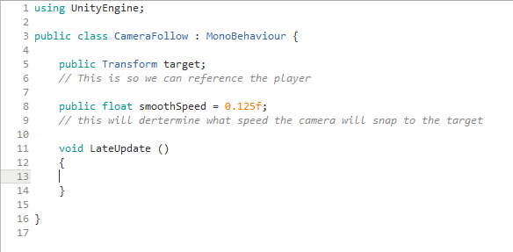
3)
Next we are going to add a new function, this will be our Update function but instead of our usual void Update we will be using void LateUpdate. The end result being that this happens straight after that of the void Update

Slide 4
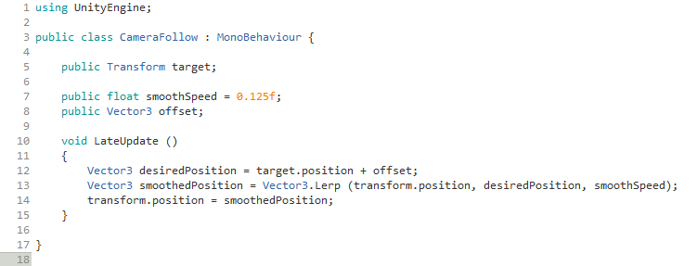
4)
Next we are going to need to make the LateUpdate actually do something and type in the following script, This will make it so that the camera will follow our object(Player) smoothly and beautifully

